Slide 1

Java 8, 9, 10 & 11 Fundamentals
Modern Java In Action
Raoul-Gabriel Urma
Mario Fusco
Alan Mycroft

Slide 2



Fundamentals
Java 8, 9, 10, and 11: what’s happening?
Get started with new Java 8 ideas
What lambda expressions are
Write code both concise and flexible
Passing code with behavior parameterization
Lambda expressions

Slide 3
Java 8, 9, 10 & 11
Java 8 - 11: What are the changes?
Coping with changing requirements
New features introduced in Java 8
3
what’s happening?

Slide 4
Java 8 - 11
What are the changes?
Summary

Slide 5
Java 8
Lambda expressions, Method Reference , Optional, Streams added.
Advanced Date , Time, Zone and Calendar Classes introduced.
Default Interface Methods and Functional Interface.
PermGen Removed.

Slide 6
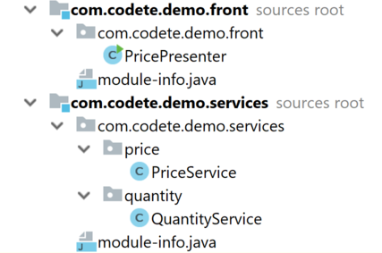
Java 9
Java Platform module system
JShell
Private interface methods
Optional Class

Slide 7
Java 9
Java Platform module system
JShell
Private interface methods
Optional Class
jshell> Stream<String> names = Stream.of("John", "George", "Susan","Tom");
names ==> ReferencePipeline$Head@6e1567f1

Slide 8
Java 9
Java Platform module system
JShell
Private interface methods
Optional Class
public interface ClientService {
private long getNumberOfAvailableItems(List<Item> items, Predicate<Item> filteringPredicate) {
return items.stream()
.filter(Item::isAvailable)
.filter(filteringPredicate)
.count();
}
default long getNumberOfWhiteItems(List<Item> items) {
return getNumberOfAvailableItems(items, item -> item.getColor() == Color.WHITE);
}
default long getNumberOfRedItems(List<Item> items) {
return getNumberOfAvailableItems(items, item -> item.getColor() == Color.RED);
}
}

Slide 9
Java 9
Java Platform module system
JShell
Private interface methods
Optional Class
if (shoppingBasket.isPresent()) {
displayShoppingBasketContent(shoppingBasket.get());
} else {
displayEmptyShoppingBasket();
}
shoppingBasket.ifPresentOrElse(
this::displayShoppingBasketContent, this::displayEmptyShoppingBasket);
findShoppingBasket().or(() -> Optional.of(
new ShoppingBasket("empty shopping basket")));

Slide 10
Java 10
Local Variable Type Inference
Immutable Collections
Performance Improvements
Garbage Collection Improvements
var company = "Codete";
var characters = company.toCharArray();

Slide 11
Java 10
Local Variable Type Inference
Immutable Collections
Performance Improvements
Garbage Collection Improvements
private Set<String> createImmutableSet() {
Set<String> names = new HashSet<>();
names.add("John");
names.add("George");
names.add("Betty");
return Collections.unmodifiableSet(names);
}
private Set<String> createImmutableSet() {
return Set.of("John", "George", "Betty");
}
Set.copyOf();

Slide 12
Java 11
Launching simple code
Local Variable Type For Lambda
Performance Improvements
Garbage Collection Improvements
java SimpleProgram.java

Slide 13
Java 11
Launching simple code
Local Variable Type For Lambda
Performance Improvements
Garbage Collection Improvements
IntStream.of(1, 2, 3, 5, 6, 7)
.filter((var i) -> i % 2 == 0)
.forEach(System.out::println);
IntStream.of(1, 2, 3, 5, 6, 7)
.filter(i -> i % 2 == 0)
.forEach(System.out::println);

Slide 14
Summary
What are the changes
Java 8 | Java 9 | Java 10 | Java 11
Lambda expressions, Method Reference , Optional, Streams added. Advanced Date , Time, Zone and Calendar Classes introduced. PermGen Removed. | Java Platform module system JShell Private interface methods Optional Class | Local Variable Type Inference Immutable Collections Performance Improvements Garbage Collection Improvements | Launching simple code Local Variable Type For Lambda Performance Improvements Garbage Collection Improvements

Slide 15

Coping with changing requirements
Behavior parameterization
Lambda expressions
Stream processing
Other

Slide 16
Coping with changing requirements
enum Color { RED, GREEN }
@Data
@AllArgsConstructor
@NoArgsConstructor
public class Apple {
private int weight = 0;
private Color color;
}

Slide 17
Filter all the Green apples:
public static List<Apple> filterGreenApples(List<Apple> inventory) {
List<Apple> result = new ArrayList<>();
for (Apple apple: inventory){
if ( GREEN.equals(apple.getColor() ) {
result.add(apple);
}
}
return result;
}

Slide 18
Filter all the Red apples:
public static List<Apple> filterApplesByColor(List<Apple> inventory, Color color) {
List<Apple> result = new ArrayList<>();
for (Apple apple: inventory) {
if ( apple.getColor().equals(color) ) {
result.add(apple);
}
}
return result;
}

Slide 19
Filter all apples by Weight:
public static List<Apple> filterApplesByWeight(List<Apple> inventory, int weight) {
List<Apple> result = new ArrayList<>();
for (Apple apple: inventory){
if ( apple.getWeight() > weight ) {
result.add(apple);
}
}
return result;
}

Slide 20
Filter all apples by Color or Weight:
public static List<Apple> filterApples(List<Apple> inventory, Color color, int weight, boolean byColor) {
List<Apple> result = new ArrayList<>();
for (Apple apple: inventory) {
if ( (byColor && apple.getColor().equals(color)) ||
(!byColor && apple.getWeight() > weight) ){
result.add(apple);
}
}
return result;
}

Slide 21
Filter all apples using Predicate
Filter all apples by Color or Weight:
public interface ApplePredicate{
boolean test (Apple apple);
}
public class AppleHeavyWeightPredicate implements ApplePredicate {
public boolean test(Apple apple) {
return apple.getWeight() > 150;
}
}
public class AppleGreenColorPredicate implements ApplePredicate {
public boolean test(Apple apple) {
return GREEN.equals(apple.getColor());
}
}

Slide 22
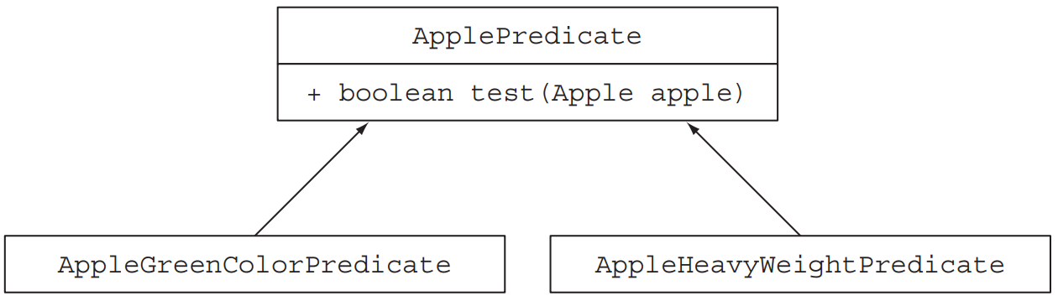
Filter all apples using Predicate
Filter all apples by Color or Weight:
public static List<Apple> filterApples(List<Apple> inventory, ApplePredicate p) {
List<Apple> result = new ArrayList<>();
for (Apple apple : inventory) {
if (p.test(apple)){
result.add(apple);
}
}
return result;
}
Filter all apples using Strategy Design Pattern
http://en.wikipedia.org/wiki/Strategy_ pattern

Slide 23
New Concepts In Java 8
Behavior parameterization
Lambda expressions
Stream processing
Other

Slide 24
Behavior parameterization
Behavior parameterization is essentially taking a block of code and making it available without executing it.
Why:
User requirements can change a lot.
Passing behavior as a parameter can help relieve the pain of change.
Logic code can be swapped out easily.
Easy to maintain and expand.

Slide 25
Filter all apples using
Anonymous Class
List<Apple> redApples = filterApples(inventory, new ApplePredicate() {
public boolean test(Apple apple){
return RED.equals(apple.getColor());
}
});

Slide 26
Filter all apples using
Anonymous Class
public class MeaningOfThis {
public final int value = 4;
public void doIt() {
int value = 6;
Runnable r = new Runnable() {
public final int value = 5;
public void run(){
int value = 10;
System.out.println(this.value);
}
};
r.run();
}
public static void main(String...args) {
MeaningOfThis m = new MeaningOfThis();
m.doIt();
}
}

Slide 27
Methods are First-class values
Methods are able to be passed around just like values.
When you use File::isHidden you create a method reference.
File[] hiddenFiles = new File(".").listFiles(new FileFilter() {
public boolean accept(File file) {
return file.isHidden();
}
});
File[] hiddenFiles = new File(".").listFiles(File::isHidden);

Slide 28
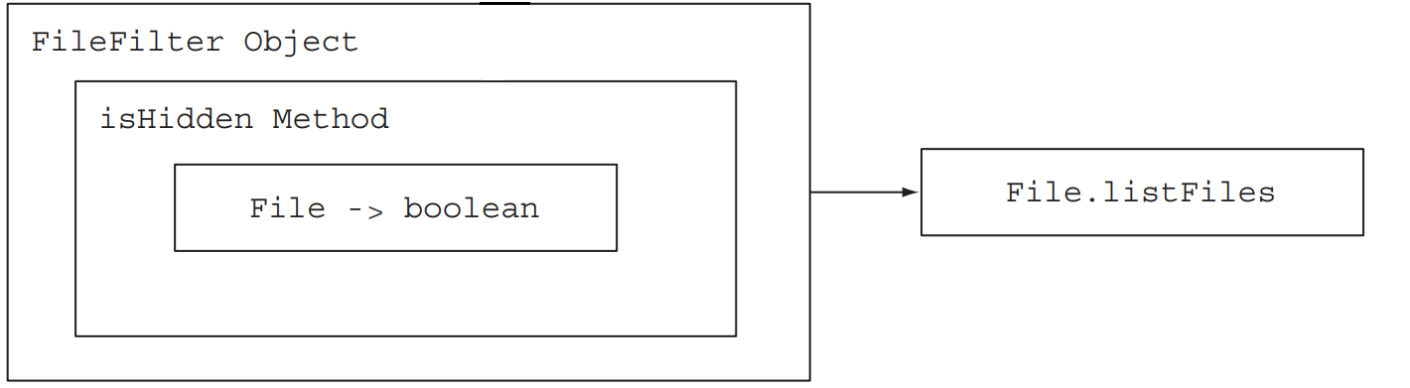
Methods are First-class values
File[] hiddenFiles = new File(".").listFiles(new FileFilter() {
public boolean accept(File file) {
return file.isHidden();
}
});

Slide 29
Methods are First-class values
File[] hiddenFiles = new File(".").listFiles(File::isHidden);

Slide 30
Filter all apples using
Lambda expression
List<Apple> redApples = filterApples(inventory, new ApplePredicate() {
public boolean test(Apple apple){
return RED.equals(apple.getColor());
}
});
List<Apple> result = filterApples(inventory, (Apple apple) -> RED.equals(apple.getColor()));

Slide 31
Filter all objects using
Generics
public interface Predicate<T> {
boolean test(T t);
}
public static <T> List<T> filter(List<T> list, Predicate<T> p) {
List<T> result = new ArrayList<>();
for(T e: list) {
if(p.test(e)) {
result.add(e);
}
}
return result;
}

Slide 32
Lambda Expression
A concise representation of an anonymous function that can be passed around.
Anonymous: doesn’t have an explicit name
Function: isn’t associated with a particular class.
Passed around: can be passed as argument to a method or stored in a variable.
Concise: don’t need to write a lot like for anonymous classes.

Slide 33
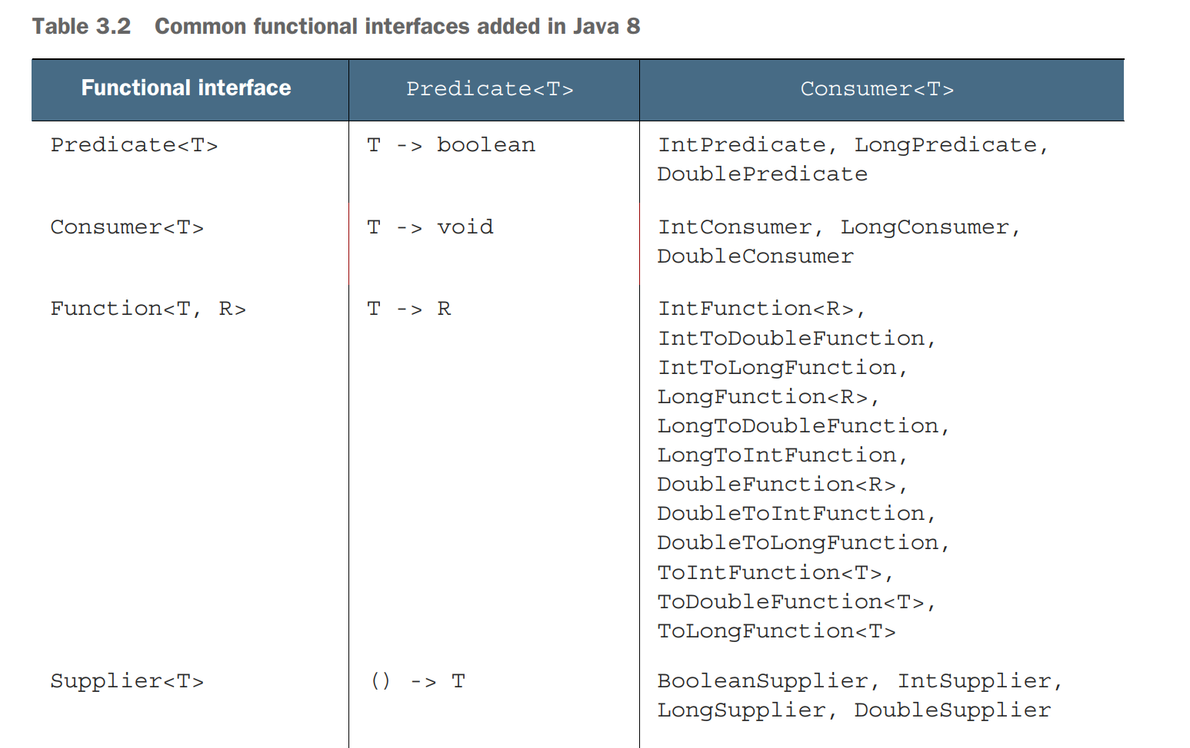
Functional Interface

Slide 34
Stream processing
A sequence of elements from a source that supports aggregate operations on them.
A Stream is:
Not a data structure
Designed for lambdas
Do not support indexed access
Can easily be outputted as arrays or lists
Lazy access supported
Parallelizable

Slide 35
Stream - More concise code
Map<Currency, List<Transaction>> transactionsByCurrencies = new HashMap<>();
for (Transaction transaction : transactions) {
if(transaction.getPrice() > 1000){
Currency currency = transaction.getCurrency();
List<Transaction> transactionsForCurrency = transactionsByCurrencies.get(currency);
if (transactionsForCurrency == null) {
transactionsForCurrency = new ArrayList<>();
transactionsByCurrencies.put(currency, transactionsForCurrency);
}
transactionsForCurrency.add(transaction);
}
}
Map<Currency, List<Transaction>> transactionsByCurrencies =
transactions.stream()
.filter((Transaction t) -> t.getPrice() > 1000)
.collect(groupingBy(Transaction::getCurrency));

Slide 36
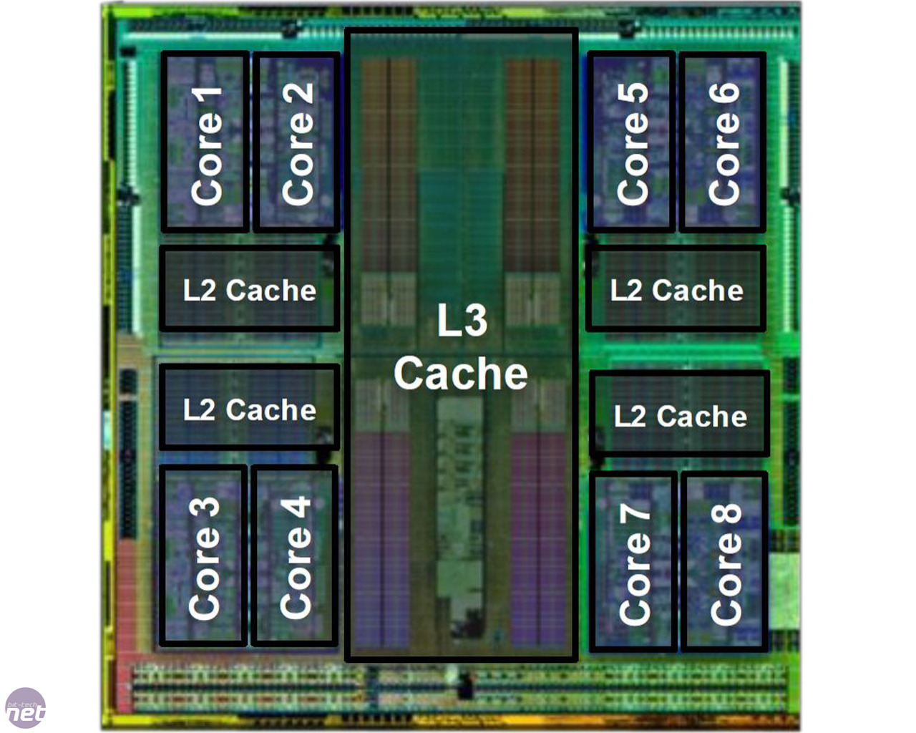
Parallelism - Problems
All computers nowadays have multicores (4 or more).
Vast majority of Java programs use only 1 core.

Slide 37
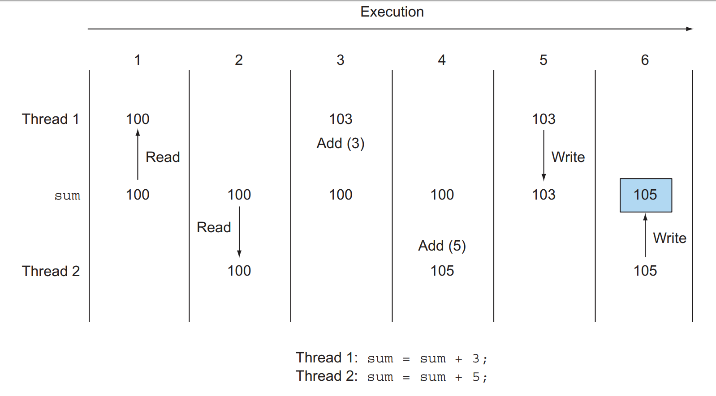
Parallelism - Problems
Working with threads is difficult and error-prone.
Big data can’t be stored in 1 computer.

Slide 38
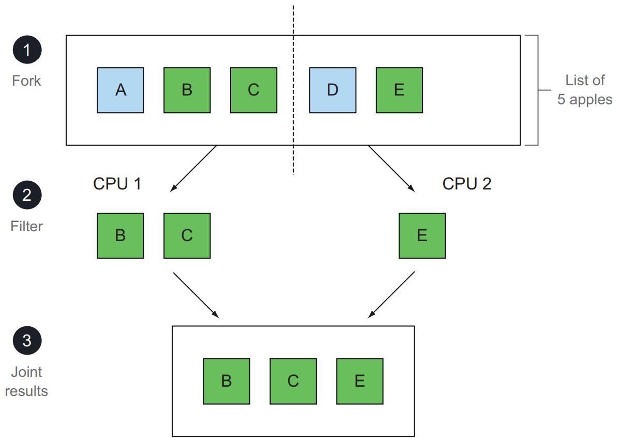
Parallelism - With Stream
List<Apple> heavyApples =
inventory.stream().filter(
(Apple a) -> a.getWeight() > 150)
.collect(toList());
List<Apple> heavyApples =
inventory.parallelStream().filter(
(Apple a) -> a.getWeight() > 150)
.collect(toList());

Slide 39
Default methods
public interface Interface {
}
public class Class1 implements Interface {
}
public class Class2 implements Interface{
}

Slide 40
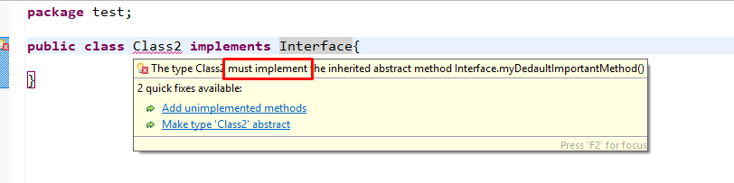
Default methods
public interface Interface {
public void myNewMethod() {
System.out.println("something");
}
}
public class Class1 implements Interface {
}
public class Class2 implements Interface {
}

Slide 41
Default method Interface
public interface Interface {
default public void myNewMethod() {
System.out.println("something");
}
}
public class Class1 implements Interface {
@Override
public void myNewMethod() {
System.out.println("something else");
}
}
public class Class2 implements Interface {
}

Slide 42
Optional
“I call it my billion-dollar mistake. It was the invention of the null reference in 1965. . . .I couldn’t resist the temptation to put in a null reference, simply because it was so easy to implement.”
Tony Hoare
at QCon London 2009

Slide 43
Consumer
function which takes in one argument
& produces a result and don't return any value
T -> ()
Can be used with lambda expression or method reference

Slide 44
Consumer - accept(Object):
Void function accepts one value & performs the operation on the given argument
// Consumer to display a number
// Using lambda expression
Consumer<Integer> display = a -> System.out.println(a);
// Method reference
Consumer<Integer> display2 = ConsumerExample::printValue;
// Implement display using accept()
display.accept(10);
Output: 10

Slide 45
Consumer - andThen(Consumer):
Return a composed Consumer wherein the parameterized Consumer will be executed after the first one.
// Consumer to multiply 2 to every integer of a list
Consumer<List<Integer> > modify = list ->{
for (int i = 0; i < list.size(); i++)
list.set(i, 2 * list.get(i));
};
// Consumer to display a list of integers
Consumer<List<Integer> >
dispList = list -> list.stream().forEach(a -> System.out.print(a + " "));
List<Integer> list = new ArrayList<Integer>();
list.add(2);
list.add(1);
list.add(3);
// using addThen()
modify.andThen(dispList).accept(list);
Output: 4 2 6

Slide 46
Consumer - forEach loop:
Default method declared in Iterable and Stream interface.
forEach take a Consumer as a input parameter
Use forEach by 3 way:
List<Programing> list = new ArrayList<>();
list.add(new Programing("Java", 5));
list.add(new Programing("PHP", 2));
list.add(new Programing("C#", 1));
Consumer<Programing> consumer = (p) -> System.out.println(
"Name: " + p.language + " - Experience: " + p.experience);
// Using Consumer as a input parameter
list.forEach(consumer);
// Using method reference as a input parameter
list.forEach(Programing::print);
// Using lambda expression as a input parameter
list.forEach(s -> s.print());

Slide 47
Consumer - BiConsumer:
Normally, Consumer always accept 1 parameter.
To using 2 parameter, using interface BiConsumer
Map<String, Integer> map = new HashMap<>();
map.put("Java", 5);
map.put("PHP", 2);
map.put("C#", 1);
BiConsumer<String, Integer> biConsumer =
(key, value) -> System.out.println("Key: " + key + " - Value: " + value);
map.forEach(biConsumer);

Slide 48
Consumer - Exception:
If evaluation of function throws an error
-> it is relayed to the caller of the composed operation.
// Consumer to multiply 2 to every integer of a list
Consumer<List<Integer> > modify = list ->{
for (int i = 0; i <= list.size(); i++)
list.set(i, 2 * list.get(i));
};
Consumer<List<Integer> >
dispList = list -> list.stream().forEach(a -> System.out.print(a + " "));
System.out.println();
List<Integer> list = new ArrayList<Integer>();
list.add(2);
list.add(1);
list.add(3);
try {
dispList.andThen(modify).accept(list);
}catch (Exception e) {
System.out.println("Exception: " + e);
}
Output: 2 1 3 Exception: java.lang.IndexOutOfBoundsException: Index: 3, Size: 3

Slide 49
Supplier
Presents a function which does not take in any argument but produces a value of type T.
() -> T
// This function returns a random value.
Supplier<Double> randomValue = () -> Math.random();
// Print the random value using get()
System.out.println(randomValue.get());

Slide 50
References:
Modern Java in action
https://www.geeksforgeeks.org/
https://www.javabrahman.com/
https://gpcoder.com/

Slide 51
THANK YOU!

